Slide 1

Warning Labels for Front of Pack
Labelling (FOPL)
at
Parliamentary Roundtable Discussion on
‘The Importance of FOPL to control NCDs’
Dr. Arun Gupta MD Ped.
Convener , Nutrition Advocacy in Public Interest (NAPi) ,
Former member of PM’s Council on India’s Nutrition Challenges
arun.ibfan@gmail.com
Date: March 30th , 2022
Venue: Constitution Club, New Delhi
NAPi

Slide 2
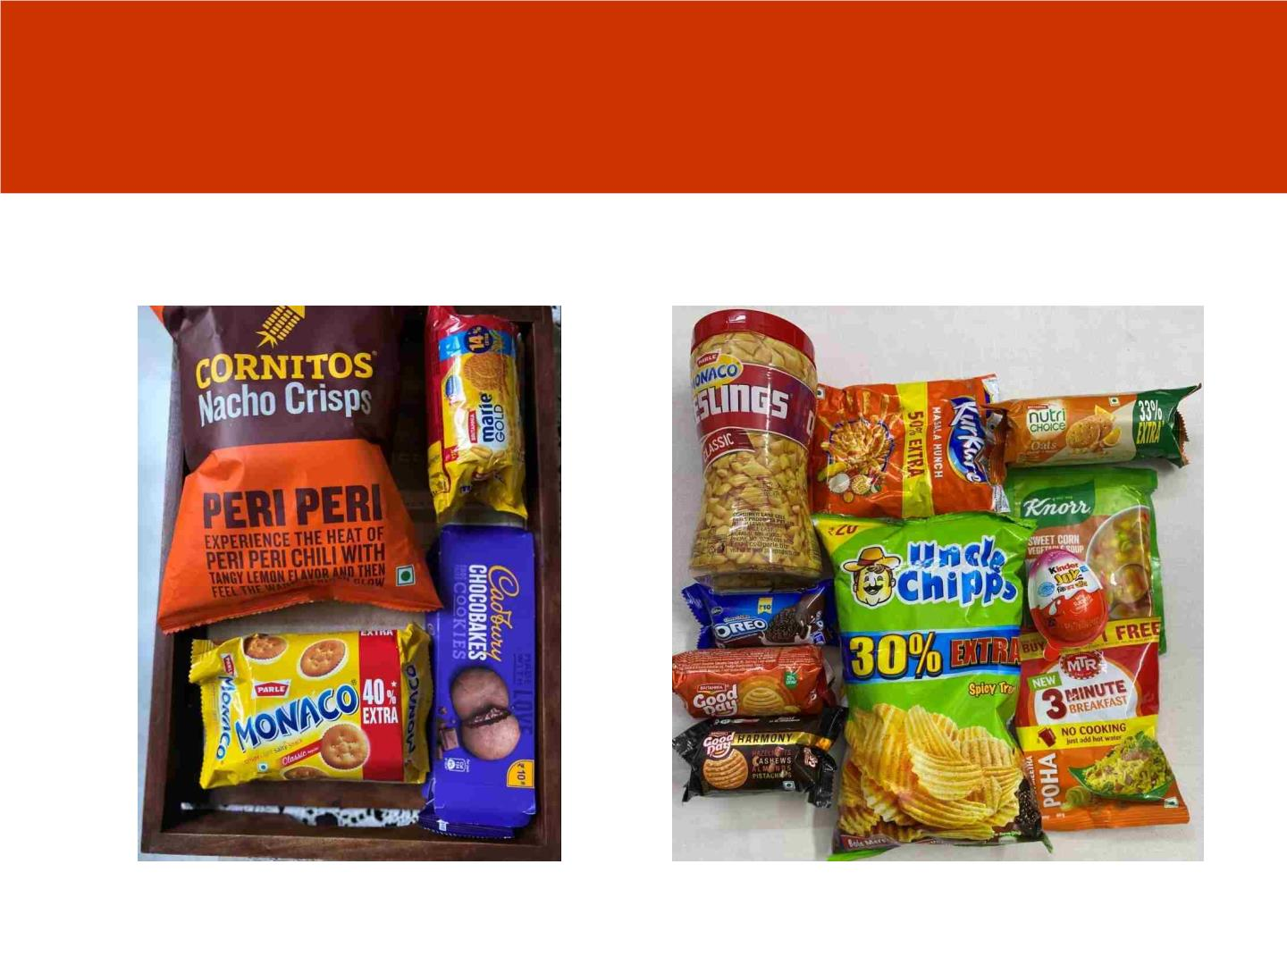
We are talking about these pacakged foods
called Ultra-processed food products(UPFs)
usually high in sugar/salt or bad fats
NAPi

Slide 3
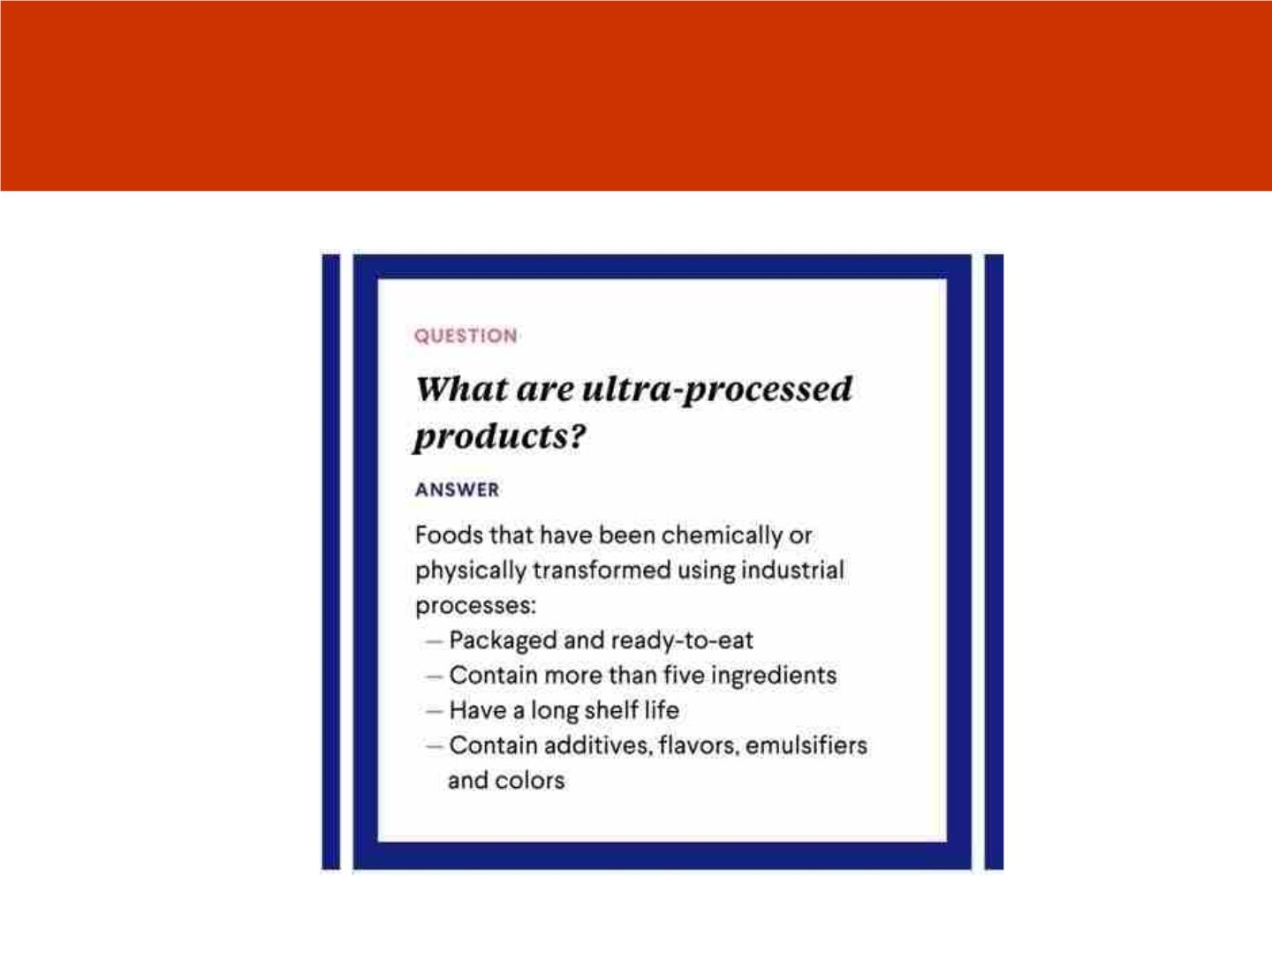
What are UPFs
NAPi

Slide 4
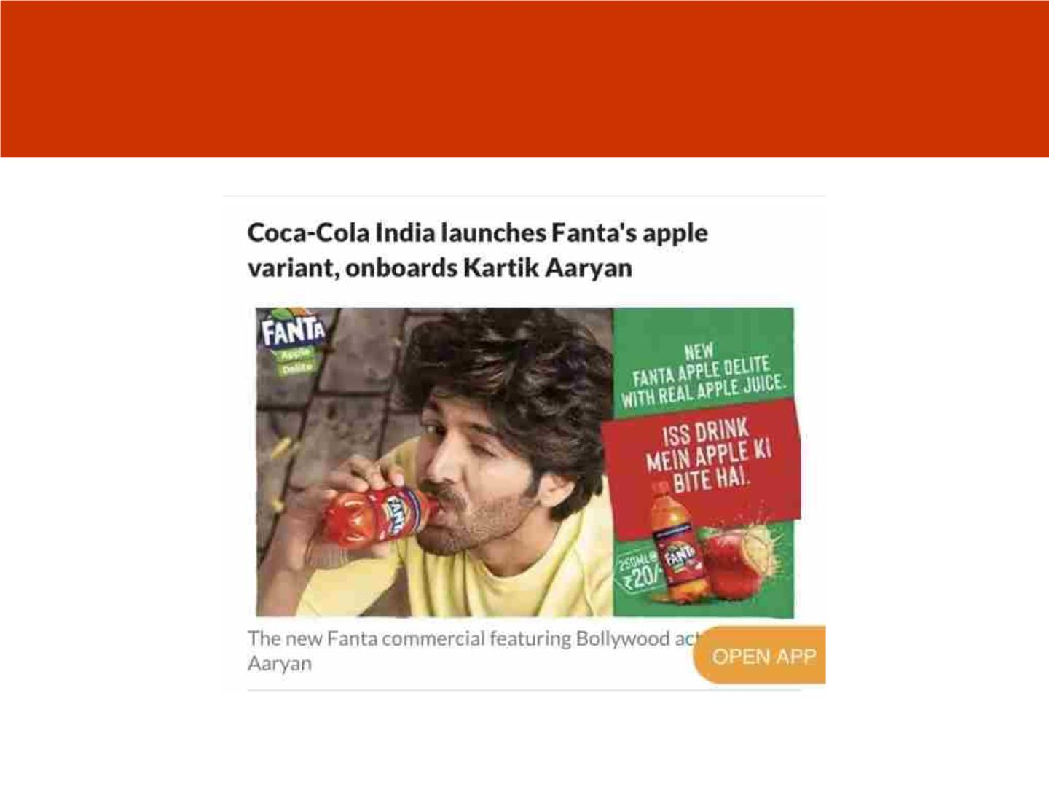
Aggressively Marketed
NAPi

Slide 5
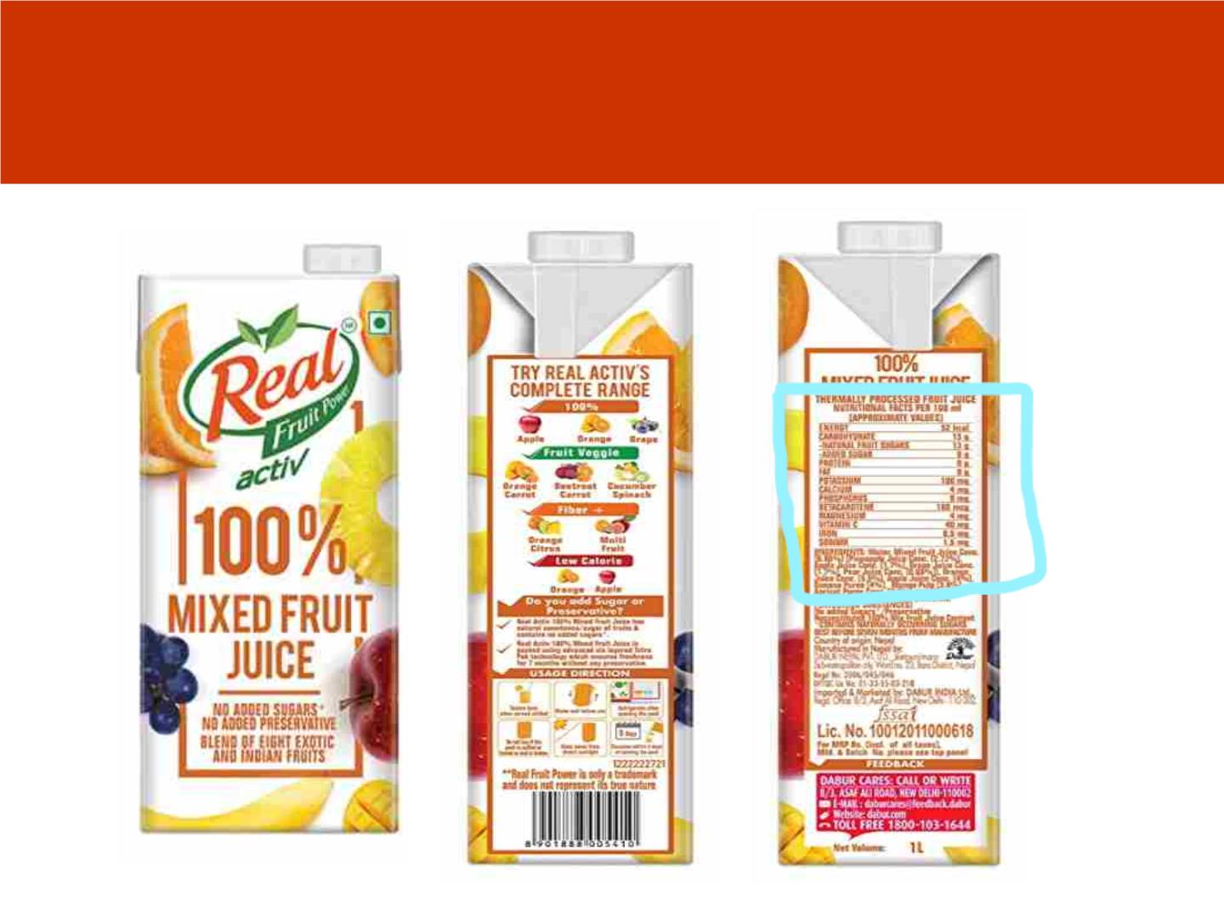
Consumers Struggle to Understand the
harmful nutrient content
NAPi

Slide 6
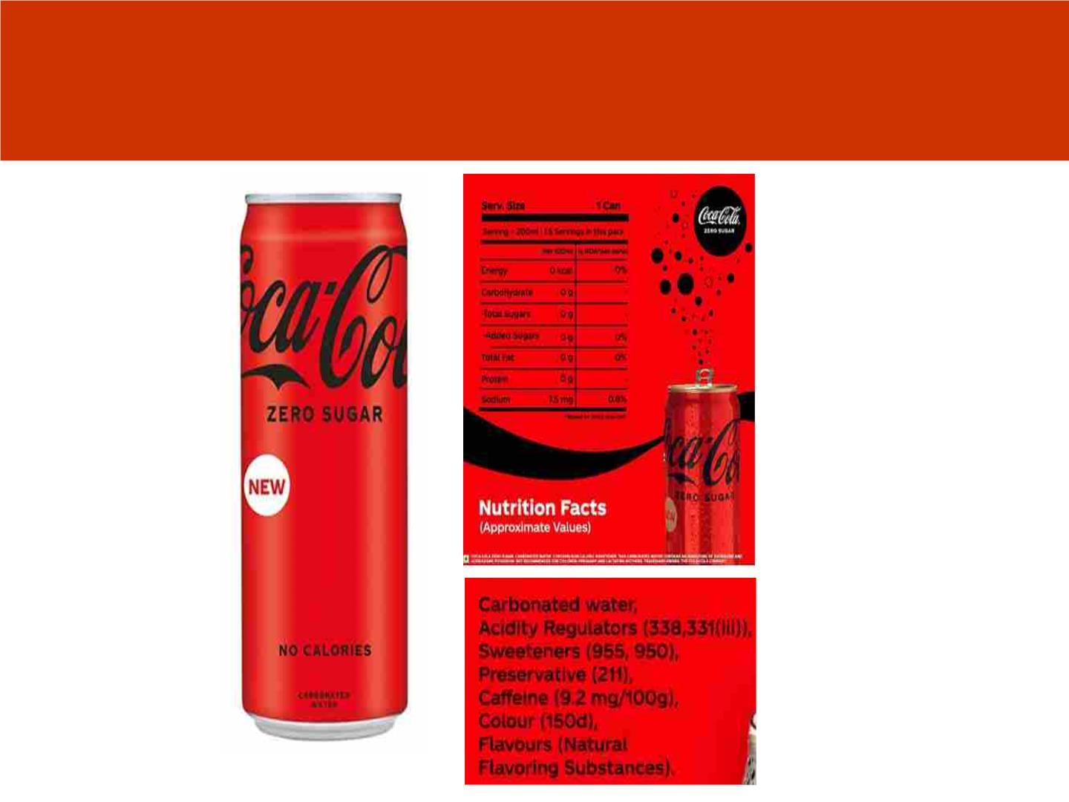
Zero Sugar Coca Cola
NAPi

Slide 7
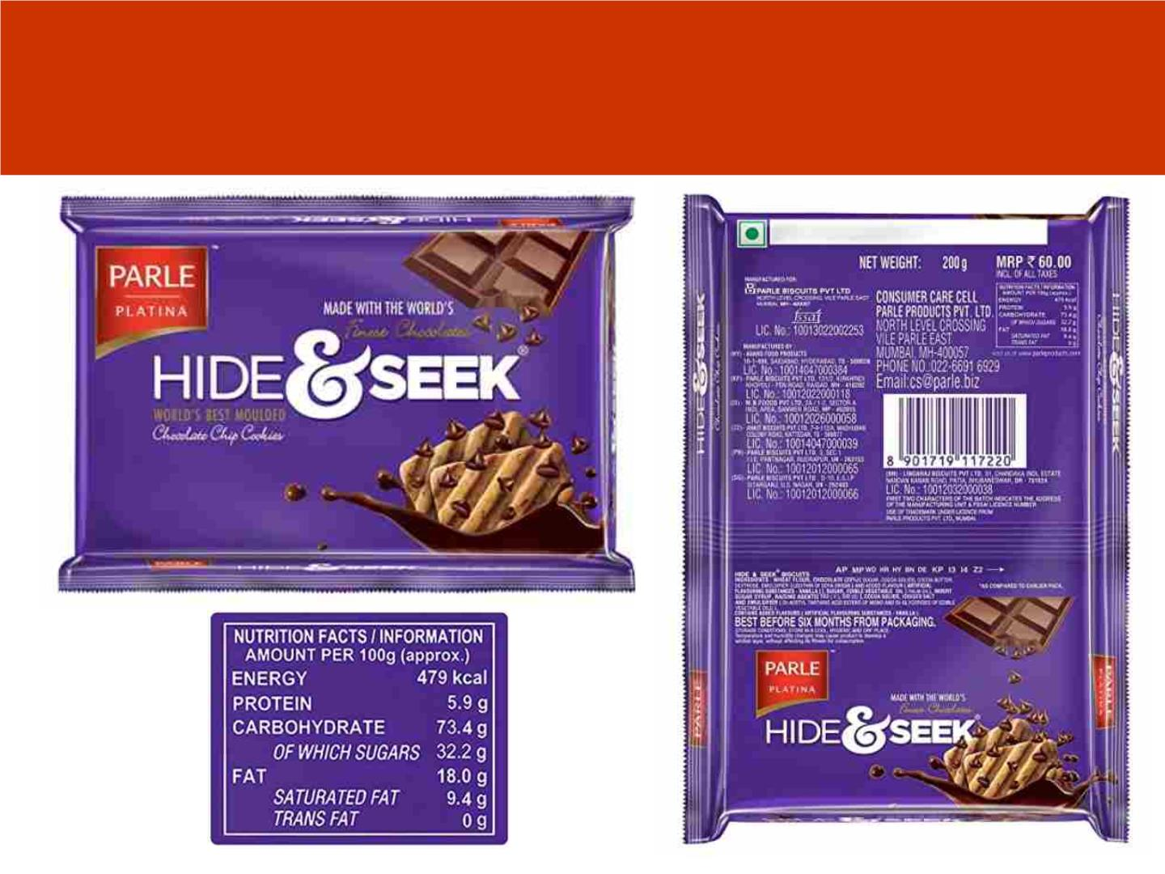
Struggle to Understand the harmful
nutrient content

Slide 8
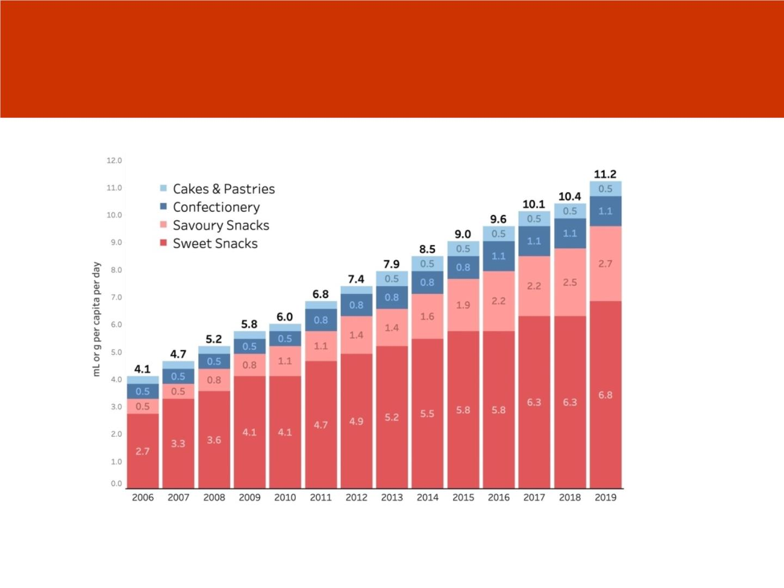
Rising Sales -Consumption of Unhealthy foods at
the expense of real or minimally processed foods
NAPi

Slide 9
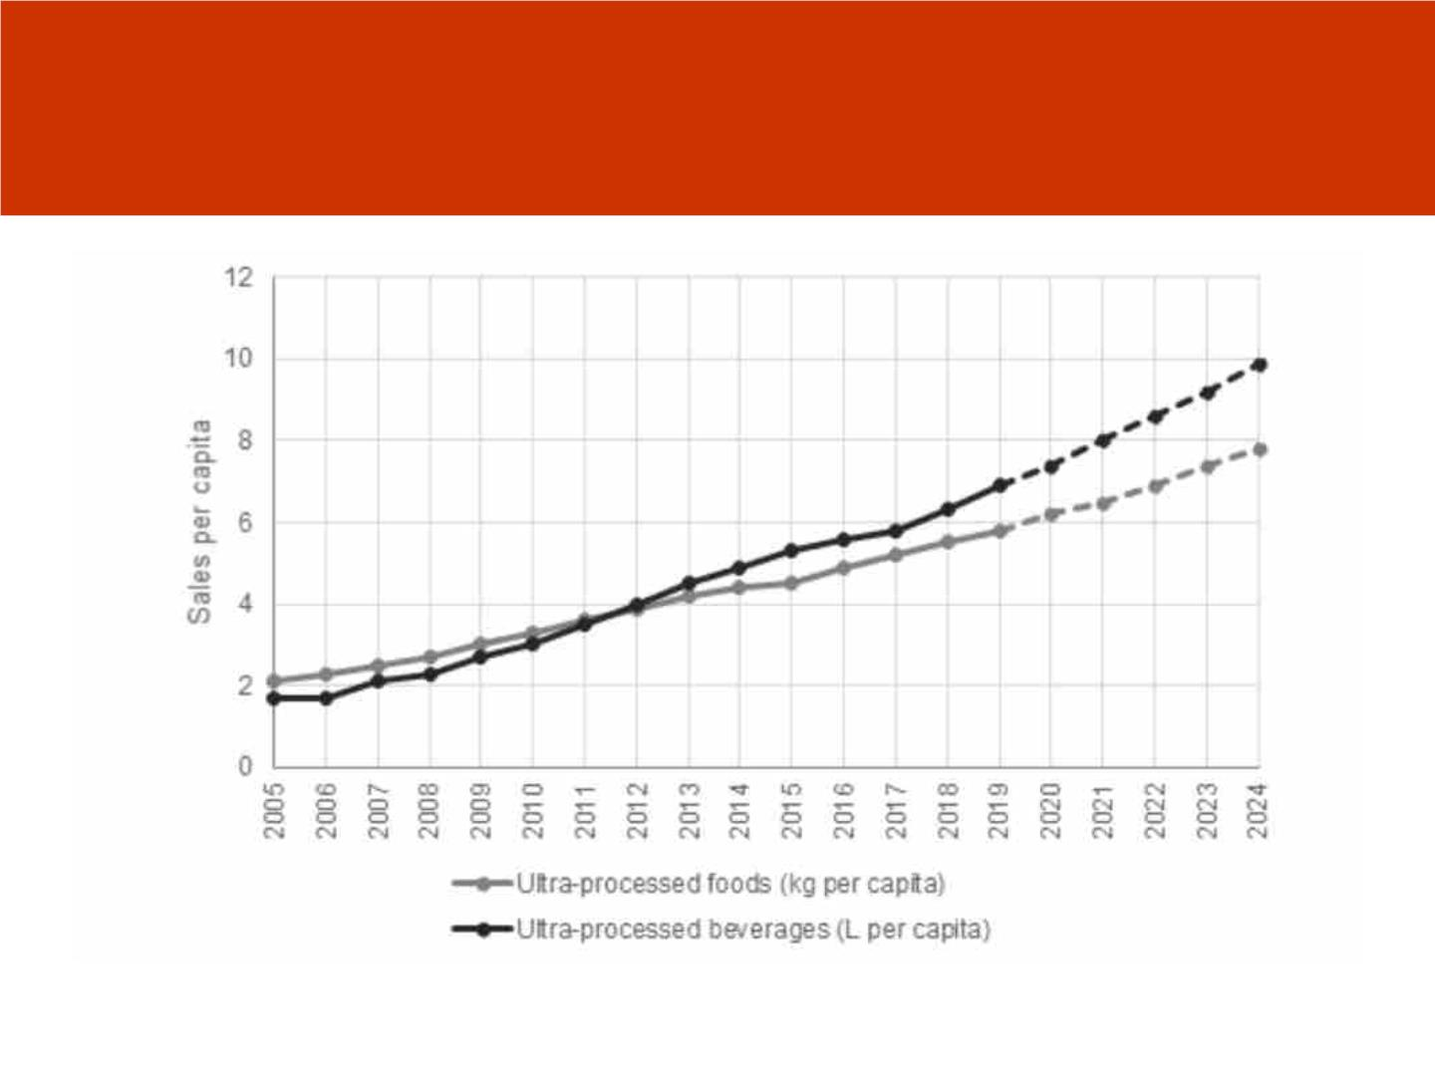
Rising Consumption of beverages in india
( Euromonitor 2019)
NAPi

Slide 10
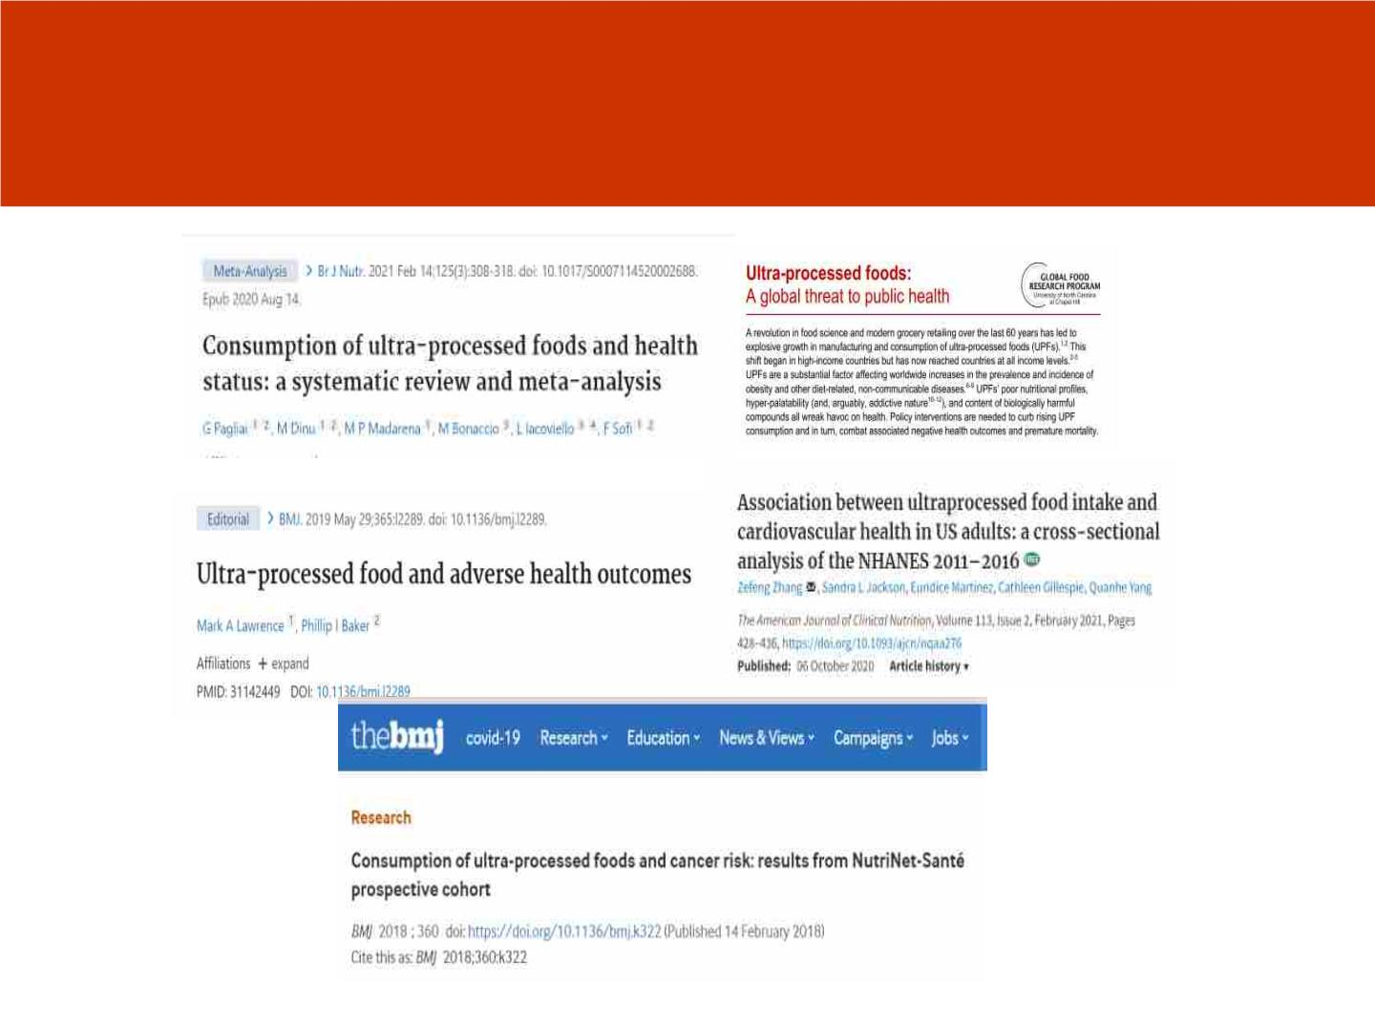
Calamity on Human Health by increased consumtion of
UPFs: Scientific Evidence has shown strong links to NCDs
NAPi

Slide 11
Evidence of the risk of death
Important findings
• A new meta-analysis of studies on the association
between UPF and selected UPF and processed
foods intakes with all-cause mortality. Compared
to low consumption, high consumption of UPF
increased death risk by 29%.
• Compared to low consumption, high
consumption of sugar sweetened beverages(SSB)
increased death risk by 11%.
NAPi

Slide 12
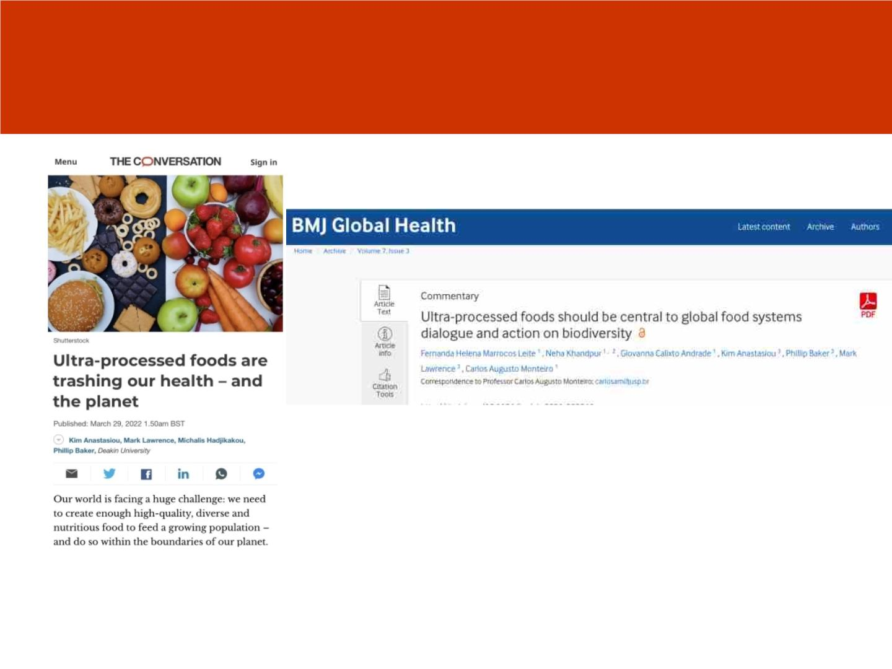
Unhealthy Food is Stronly linked to NCDs
and other damages to our environment
https://theconversation.com/ultra-processed-foods-are-trashing-our-health-and-the-planet-180115?utm_source=twitter&utm_medium=bylinetwitterbutton
NAPi

Slide 13
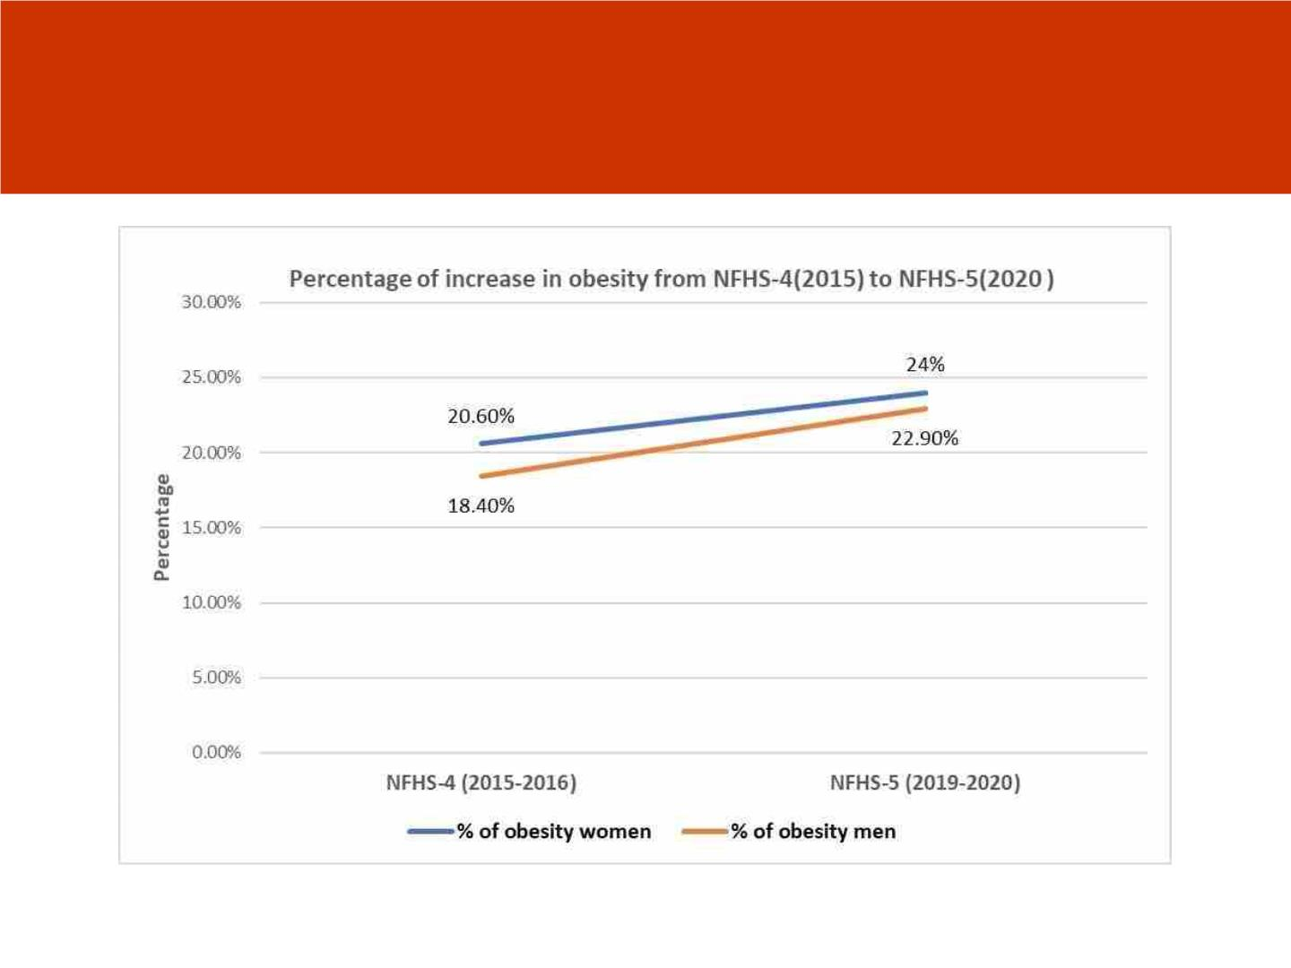
Rising Obesity in India both in men and
women 2015-2020
NAPi

Slide 14
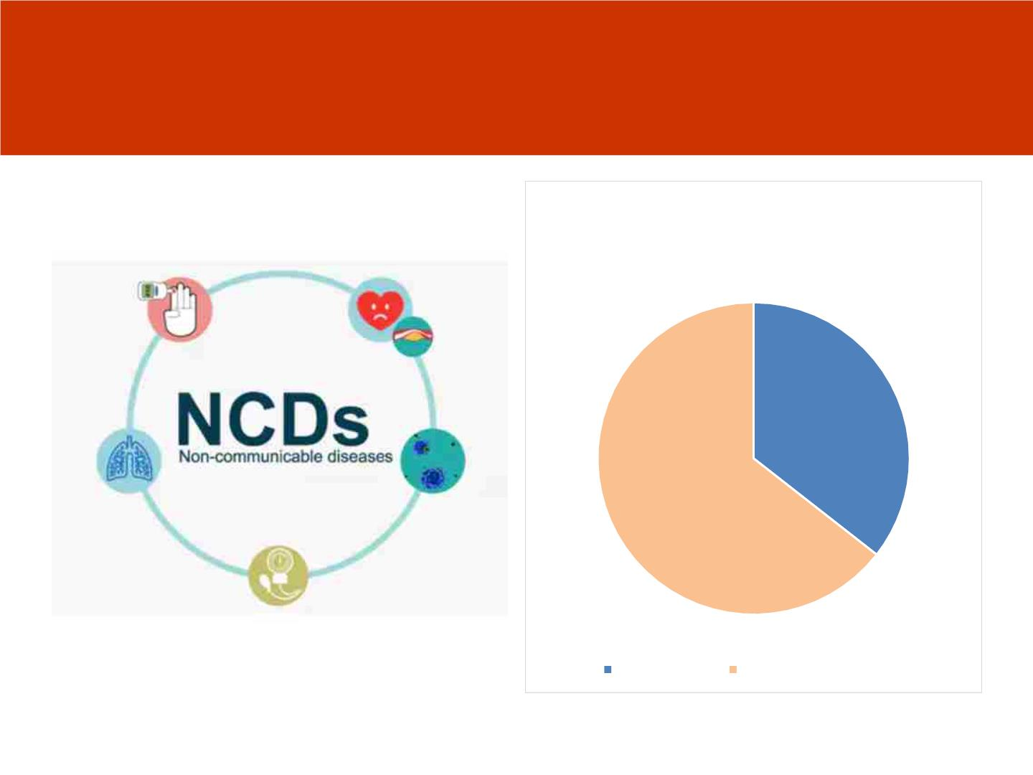
Calamity of Human Health in the form of Non
Communicable diseases : Diabetes, Cancers,
Heart Disease Hypertension and mortality
Total annual deaths in India is
approximately 9 Million & Estimated
Deaths due to NCD'S is 5.8 Million
5.8
million
Total deaths Deaths due to NCD's
NAPi

Slide 15
Policy Objective should be to
reduce and slow down the
consumption of unhealthy food
products
NAPi

Slide 16
3 policies options under consideration
• Restrict marketing
• Increasing taxes on such foods
• Front of pack labelling based on a cut off point
NAPi

Slide 17
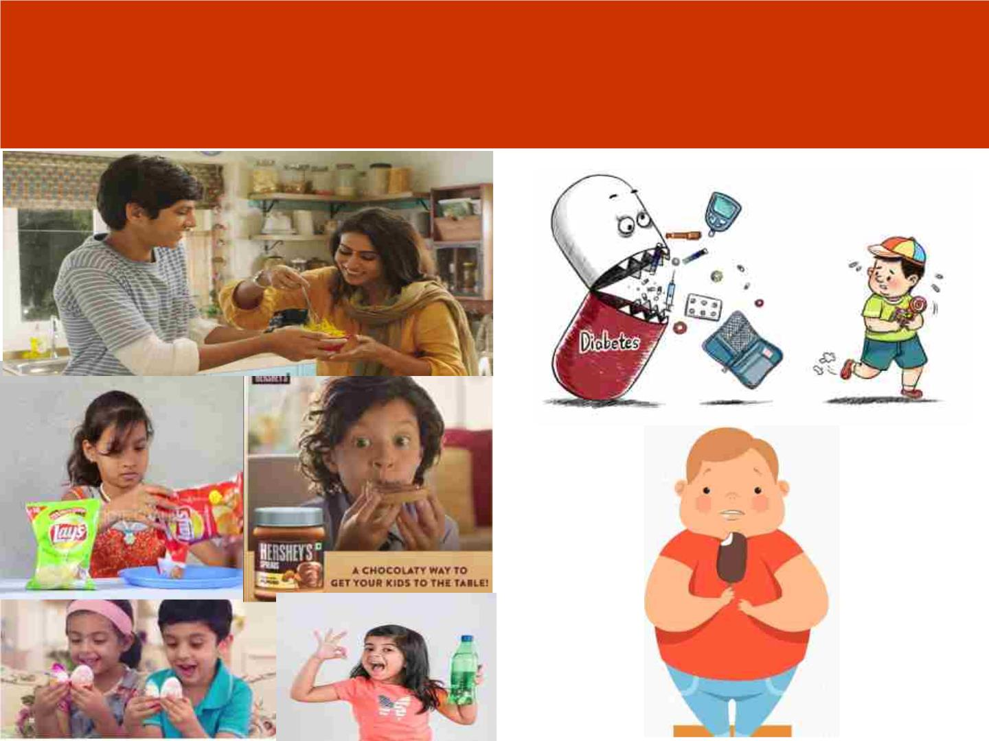
Why FOPL is needed ?
NAPi

Slide 18
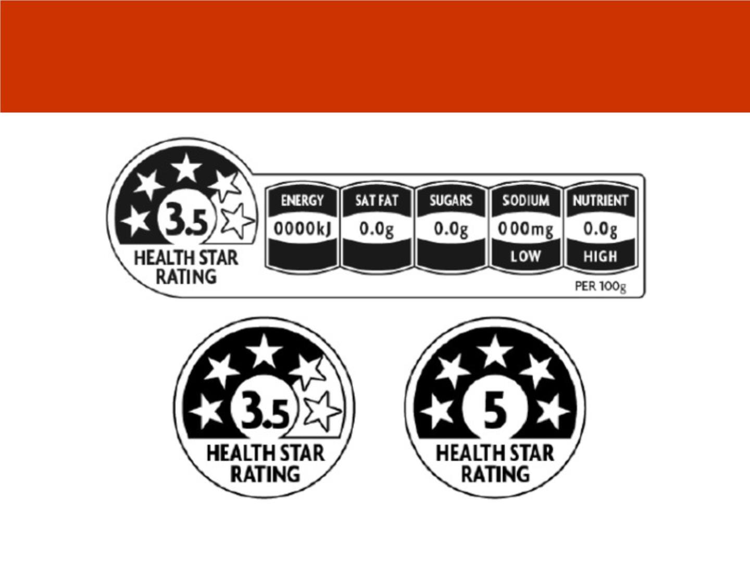
Summary score and Health Star Rating
in Aus/NZ
NAPi

Slide 19
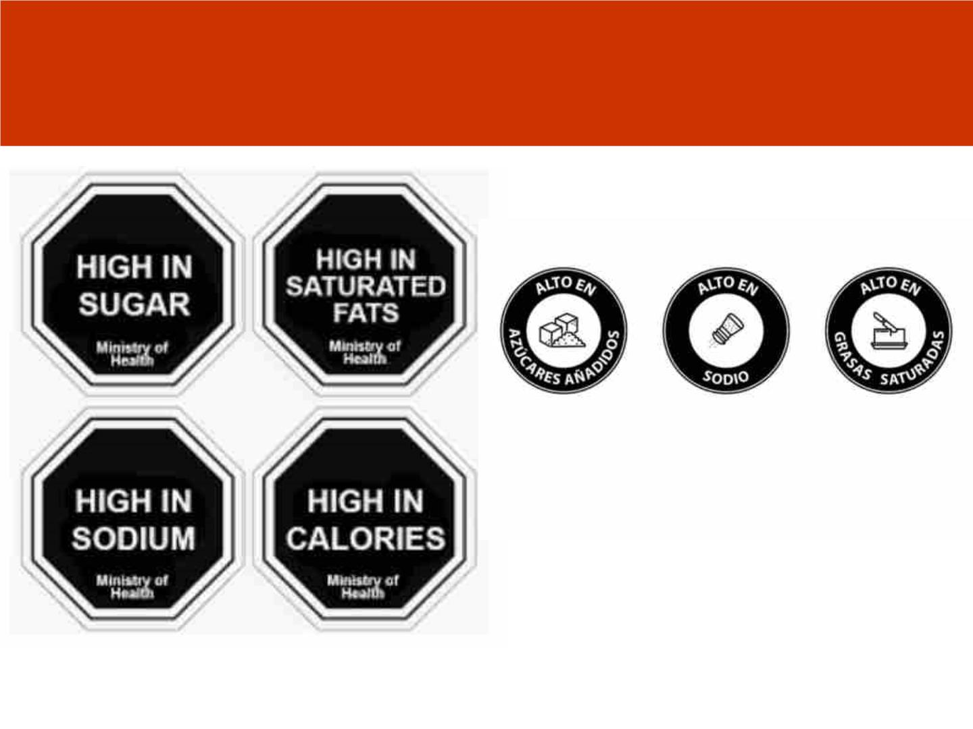
Warning labels in most of Latin
America
NAPi

Slide 20
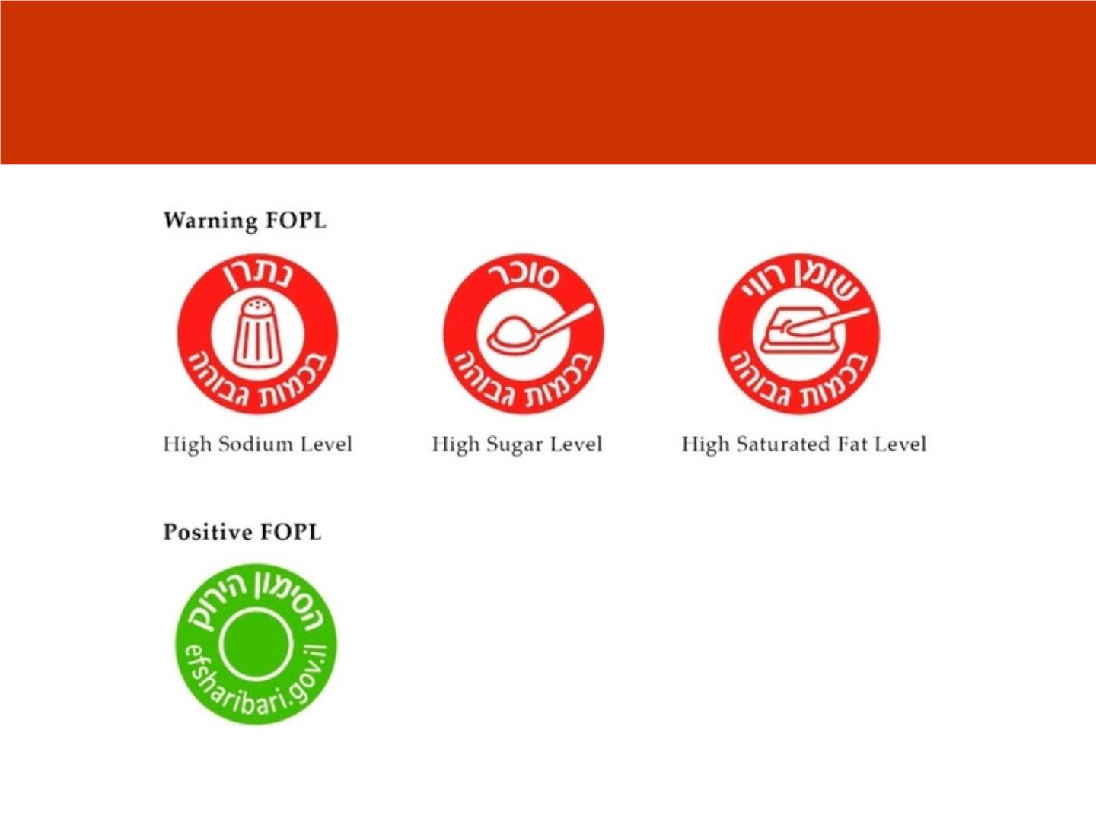
Israel
NAPi

Slide 21
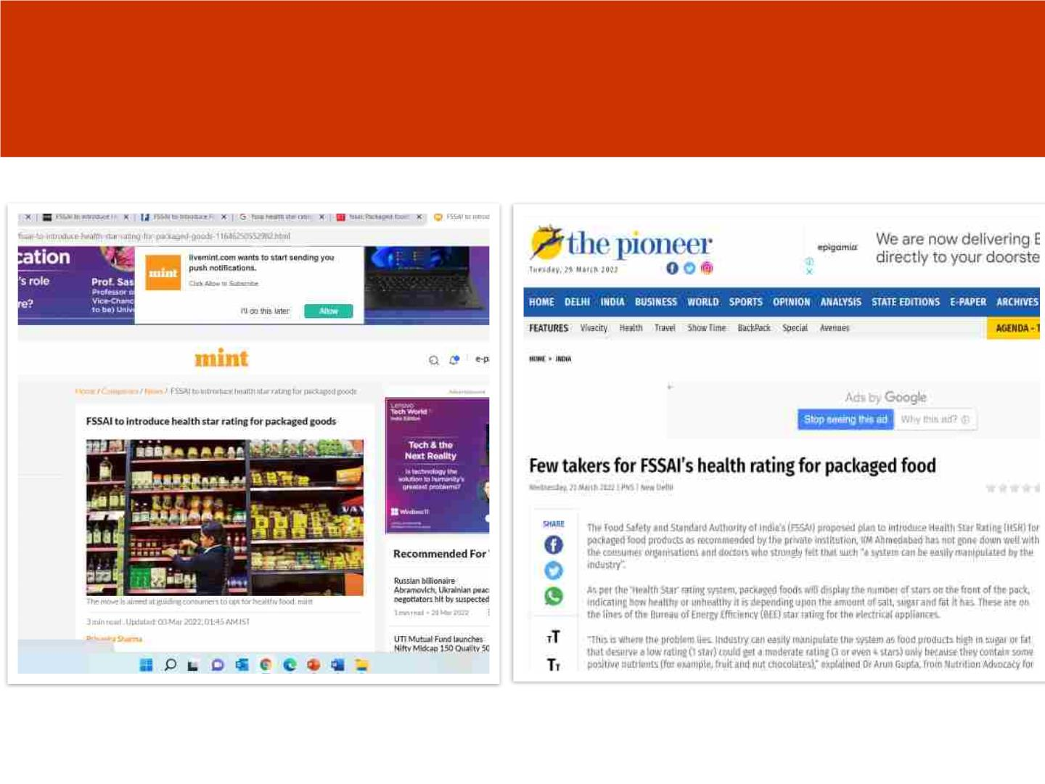
FSSAI chooses Health Star Rating and experts
and consumers prefer Warning labels
NAPi

Slide 22
What is the key to reducing
consumption of UPF?
• Ability to identify the nutrient of concern
• Need to do it quickly and easily catches their
attention
• 60% people have changed in Uruguay
• Experimental studies that measured
objectively clearly point out that it’s the
warning label that qualifies
NAPi

Slide 23
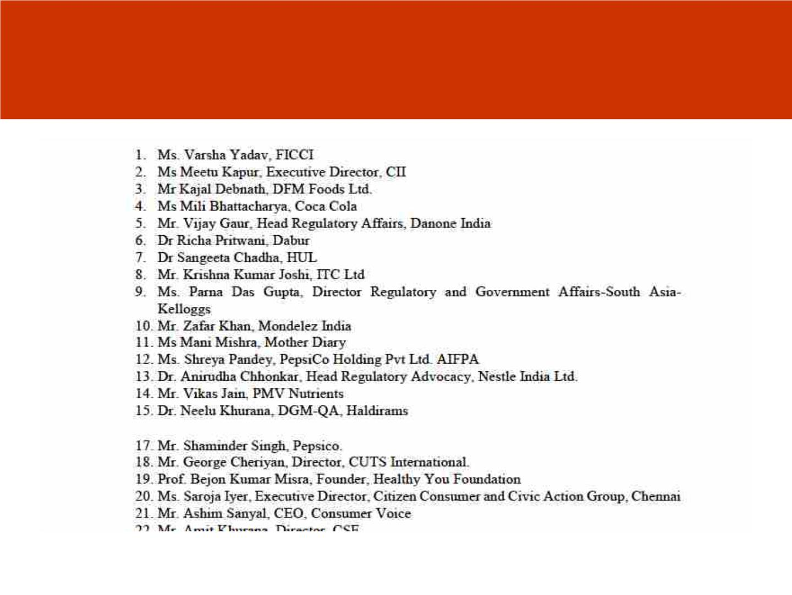
This decision is dominated by food
industry
NAPi

Slide 24
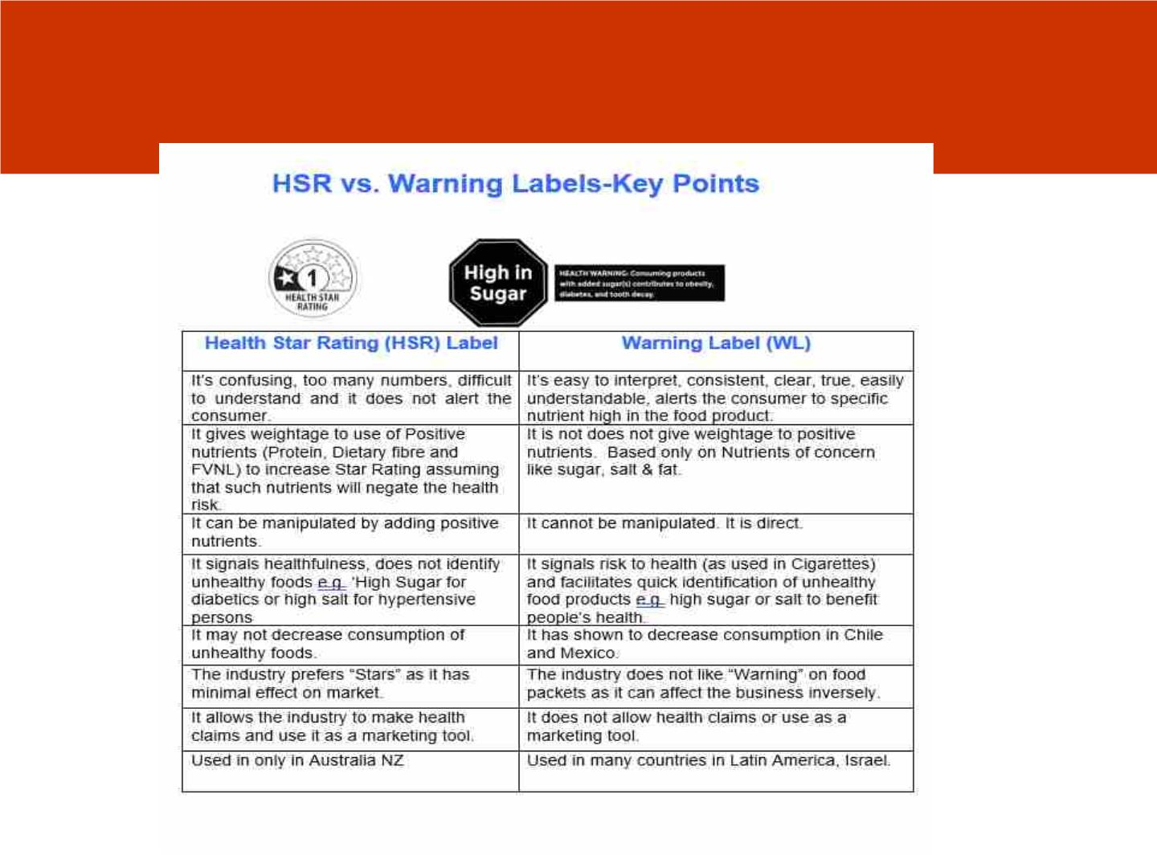
HSR V/S Warning Labels
NAPi

Slide 25
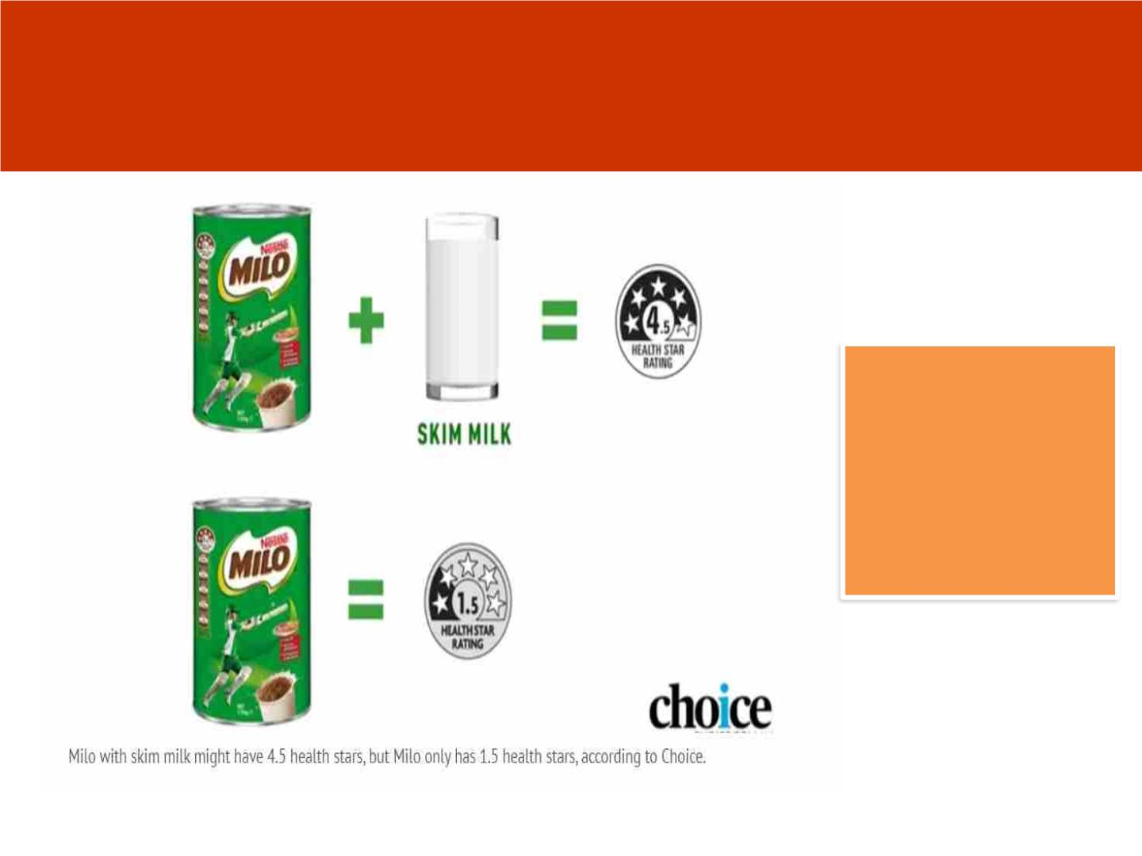
How HSR is manipulabel -Sydney
Morning Herald - March 1, 2018
Nestle was accused
of manipulating the
system and “health
washing” the sugary
product. On its own,
Milo scored a paltry
1.5 stars.
NAPi

Slide 26
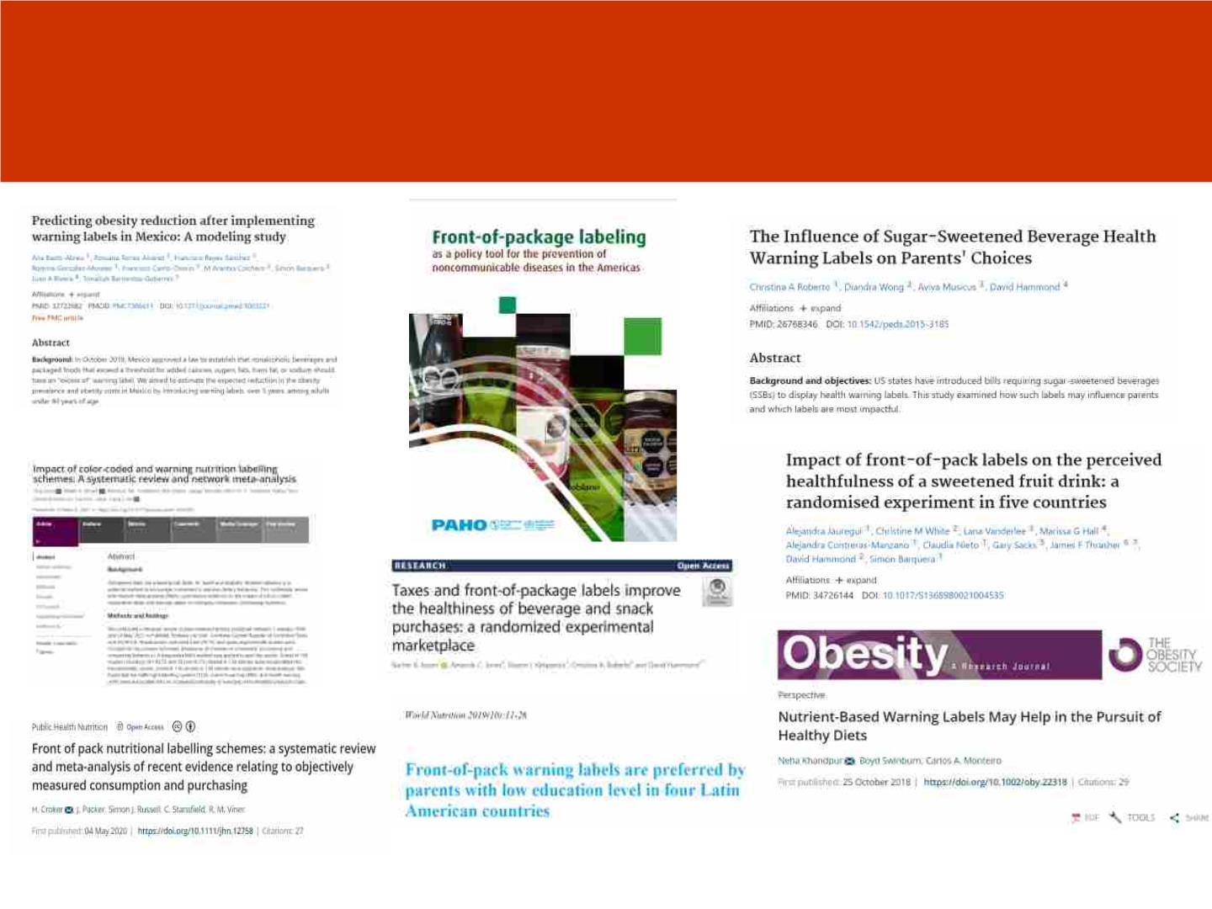
Scientific Evidence favours Warning
Label
NAPi

Slide 27
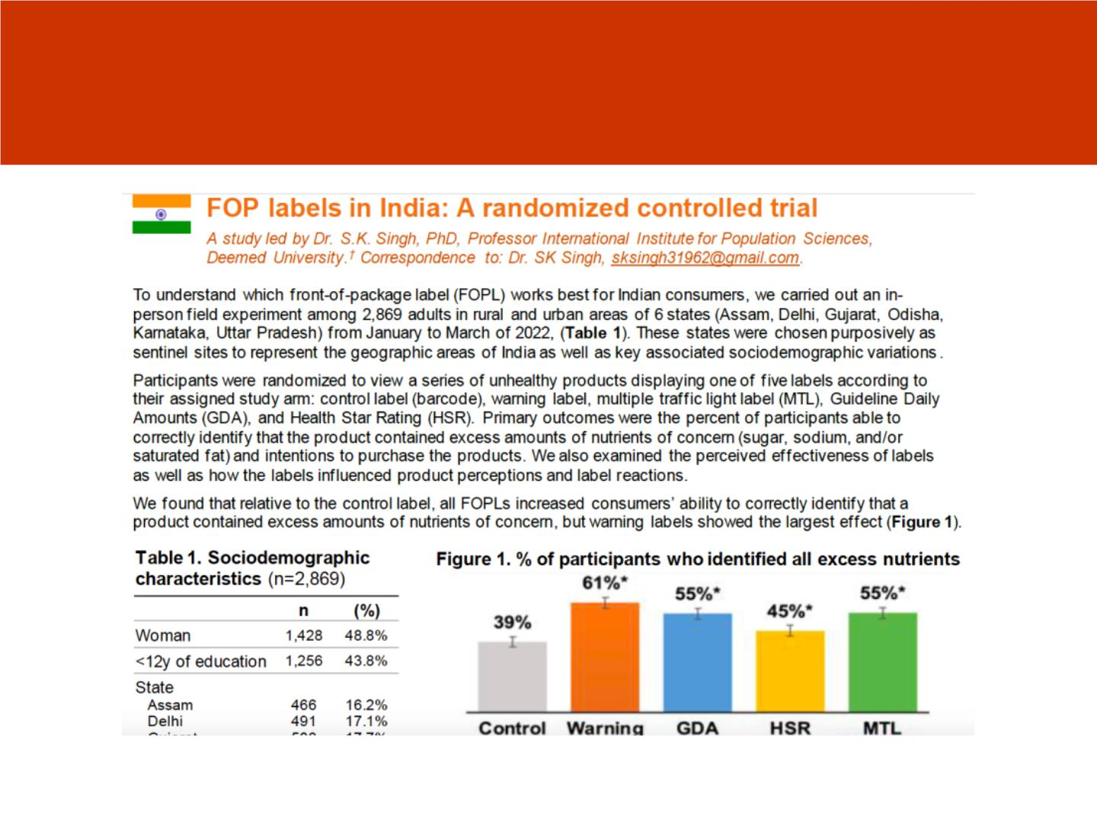
Warning Label Works : Study IIPS
Mumbai and UNC March 2022
NAPi

Slide 28
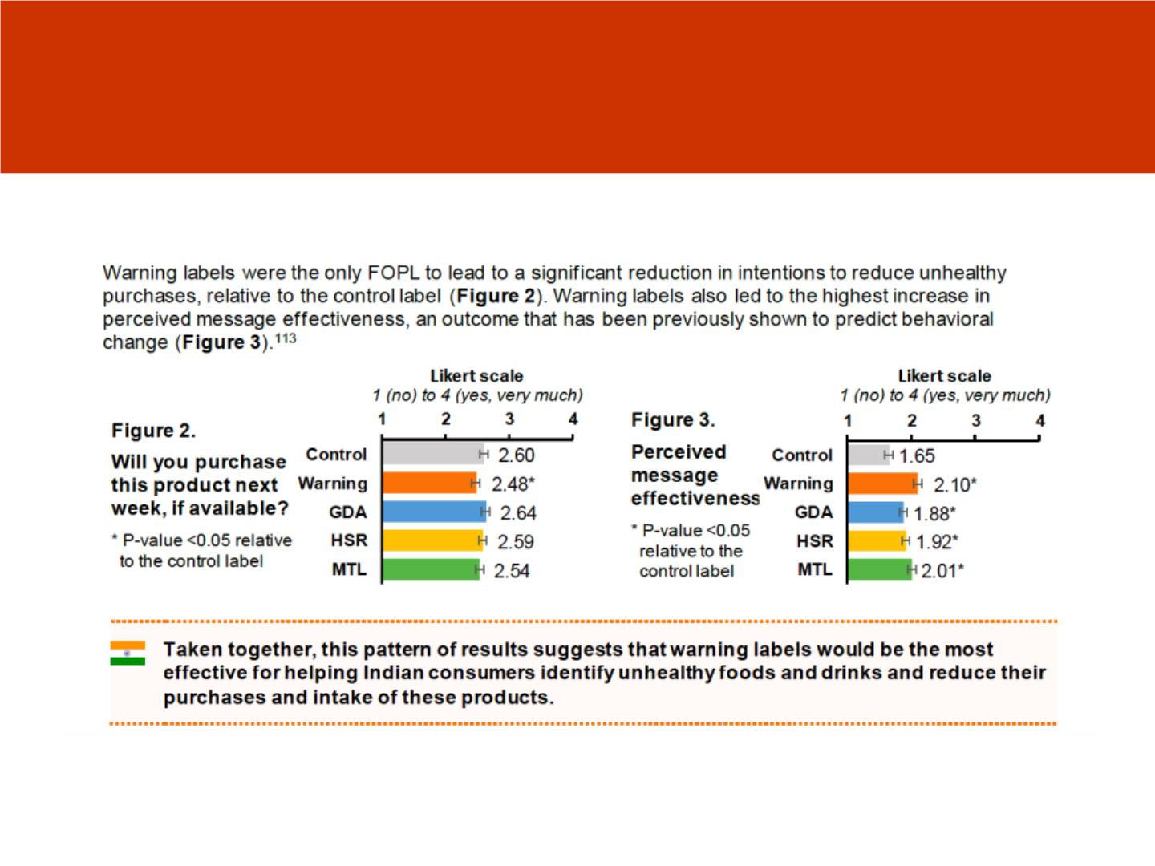
Only Warning Label was found to disrupt
consumption of unhealthy foods
NAPi

Slide 29
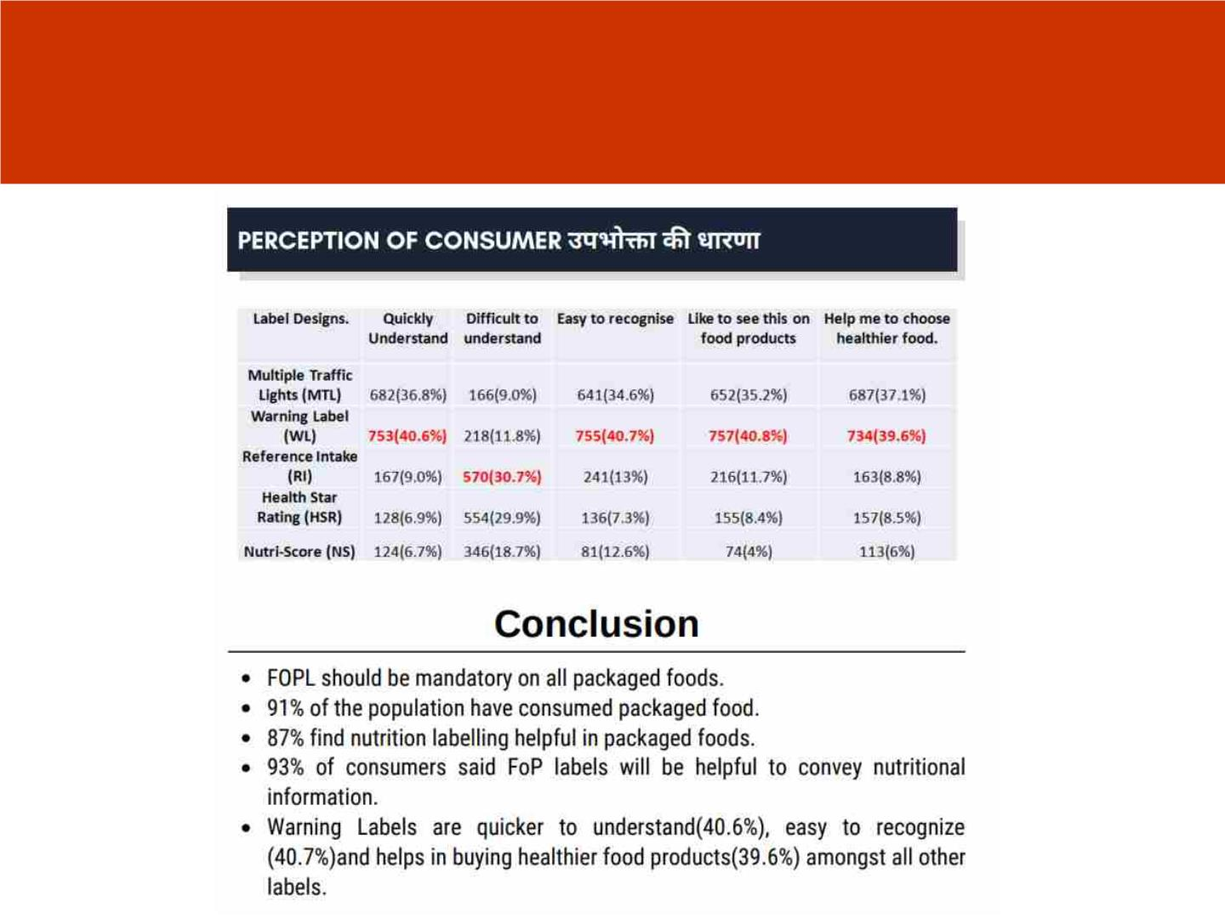
AIIMS Study Conclusion
NAPi

Slide 30
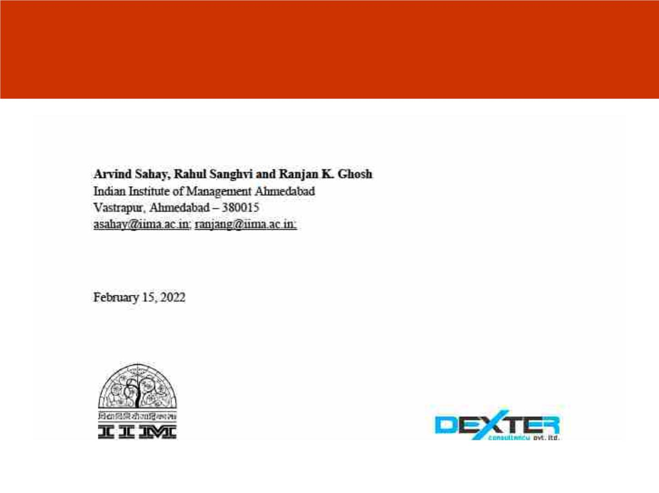
IIM Ahmedabad Study 2022
NAPi

Slide 31
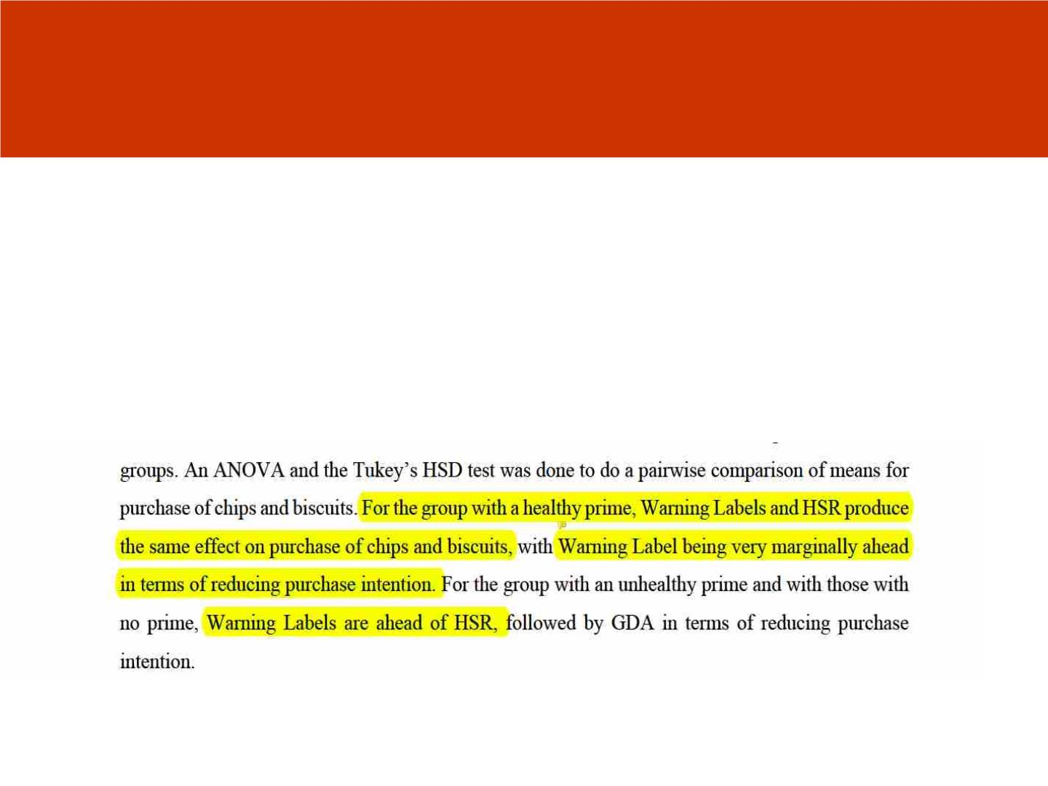
Study Findings
NAPi

Slide 32
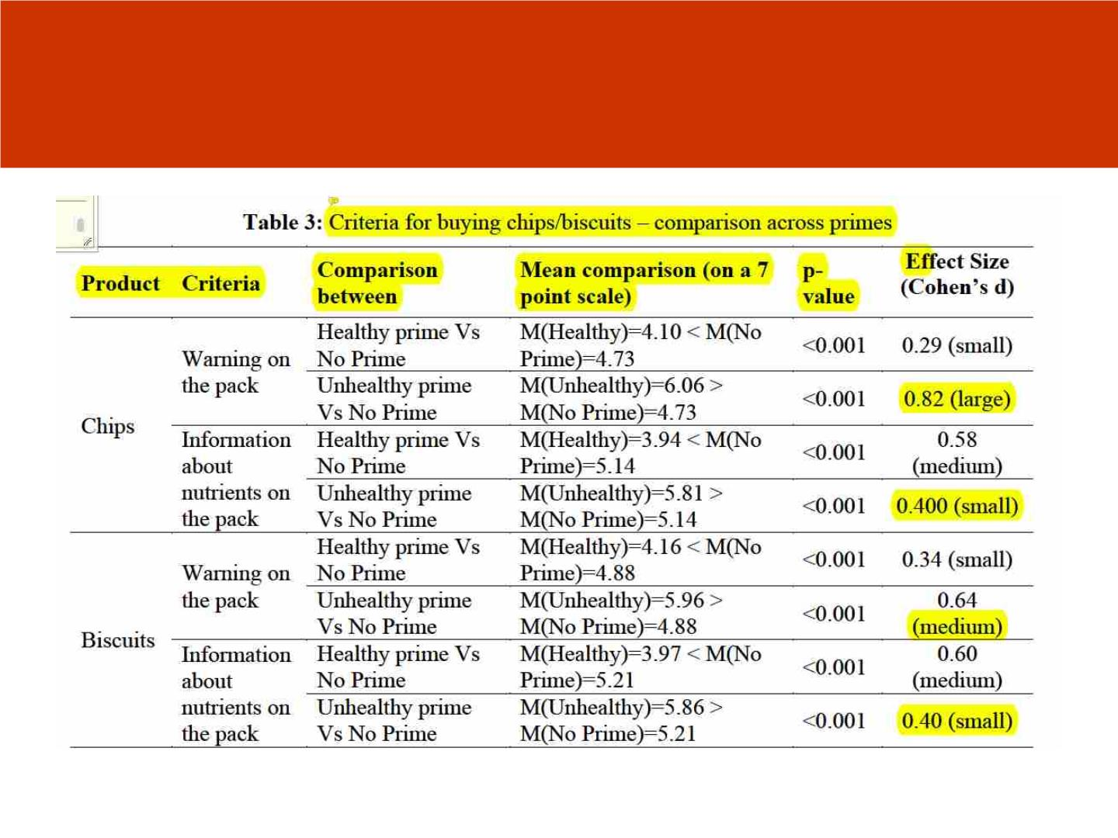
Findings of IIM Study
NAPi

Slide 33
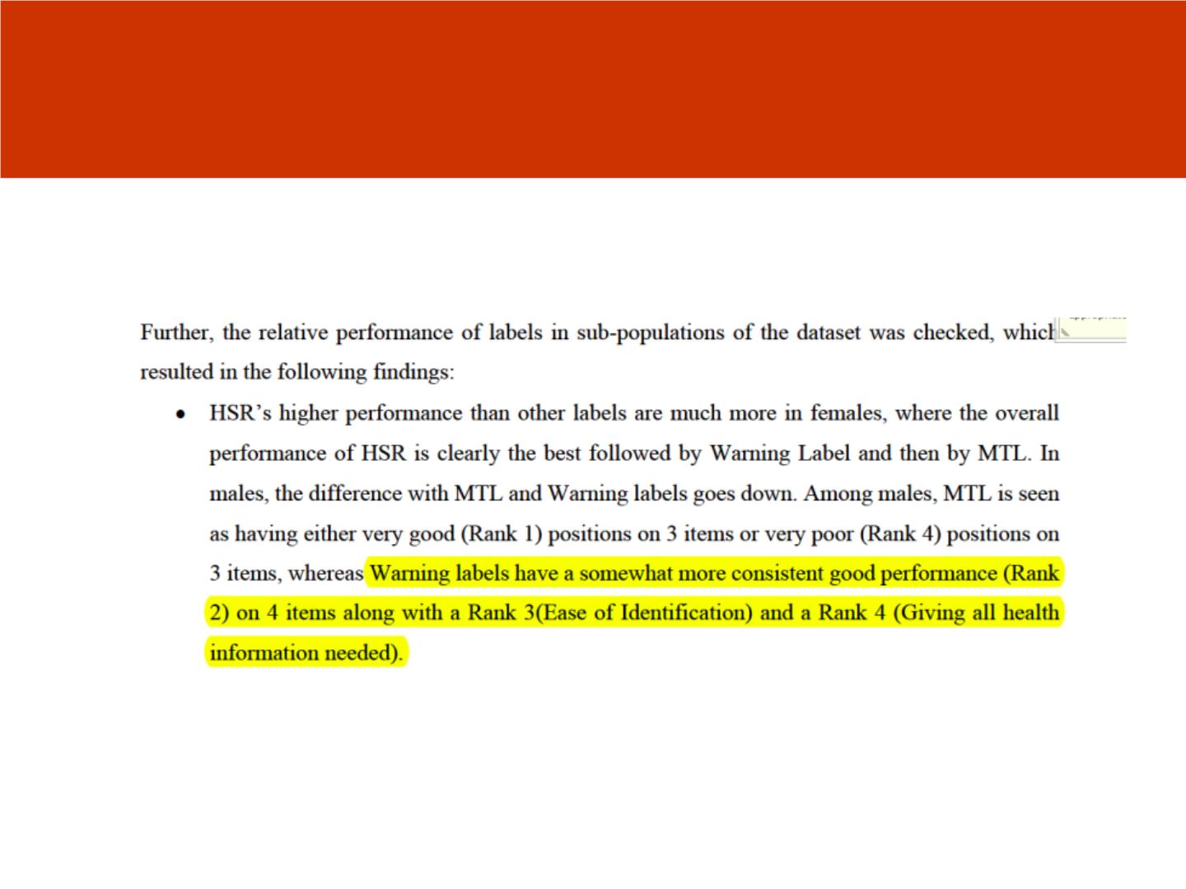
Findings of IIM Study
NAPi

Slide 34
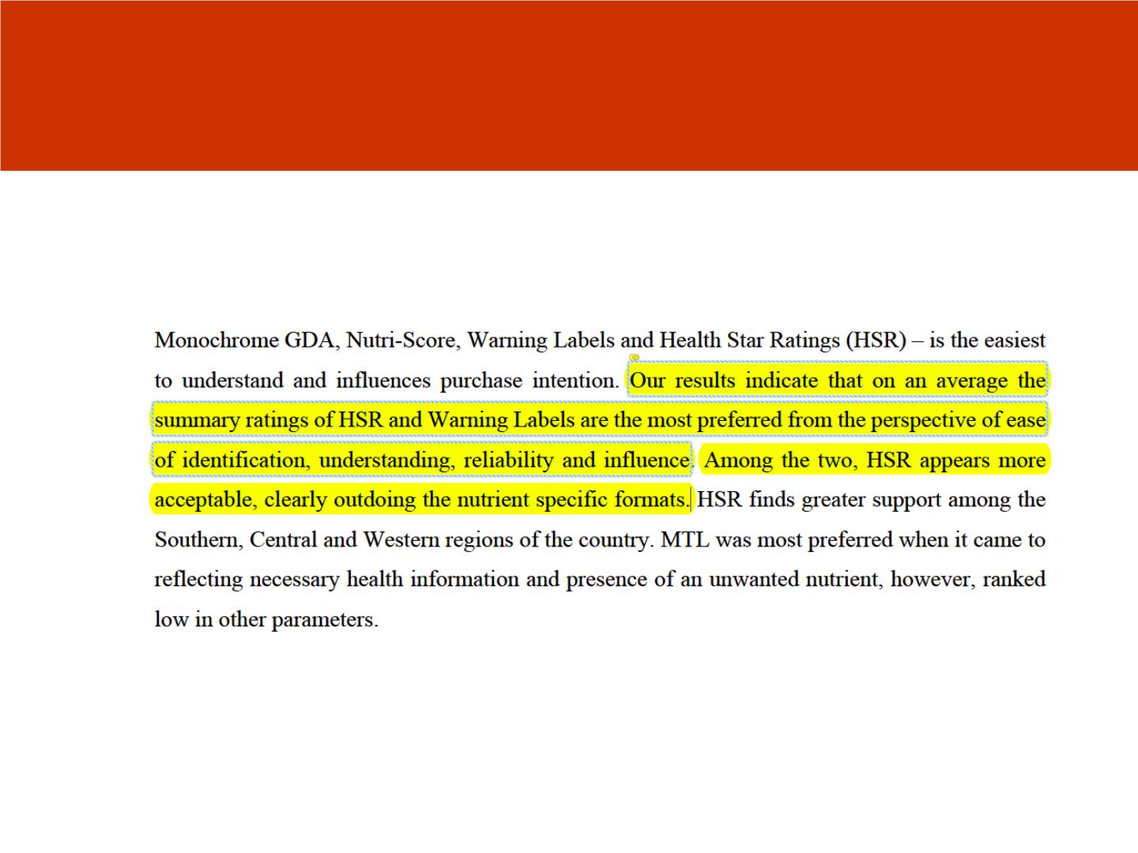
Concludes and recommends HSR
NAPi

Slide 35
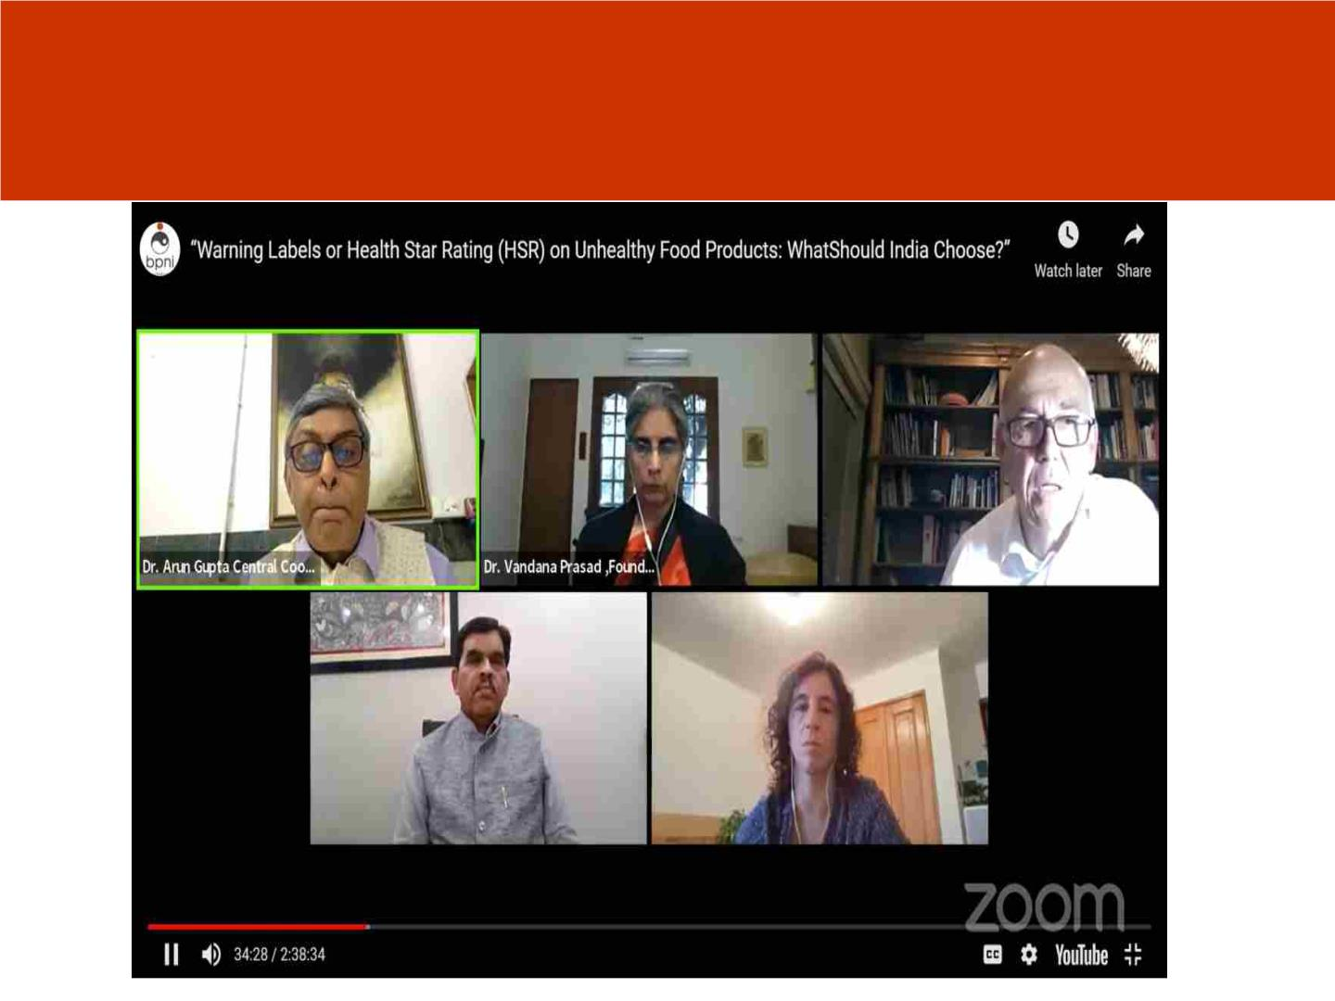
Engaging with Experts and Scientists Across the
Globe from Australia, Chile and India
NAPi

Slide 36
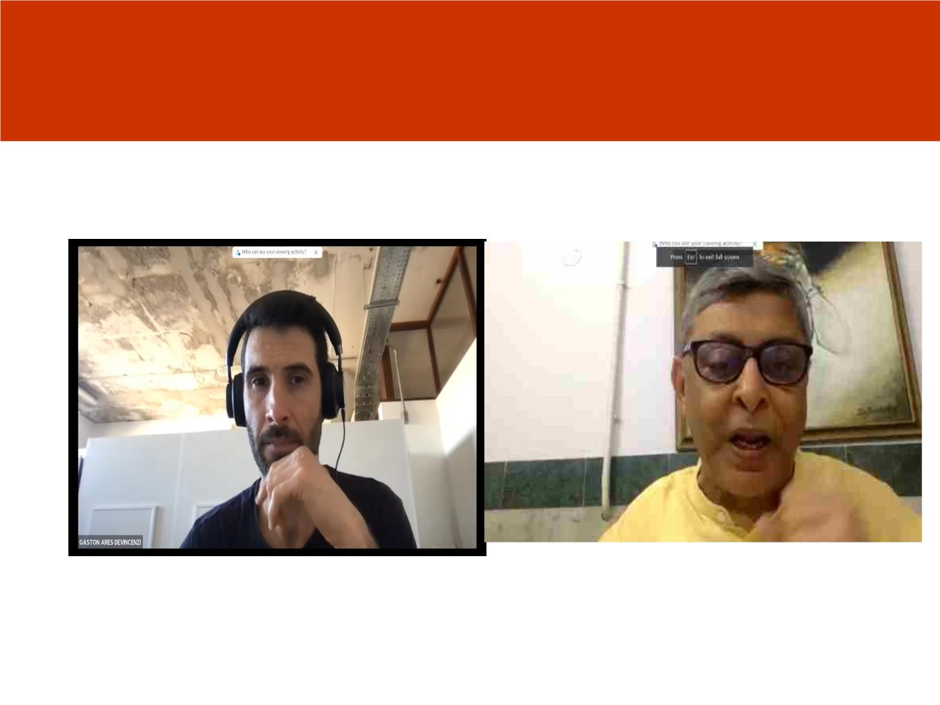
Engagement with Uruguay Expert
NAPi

Slide 37
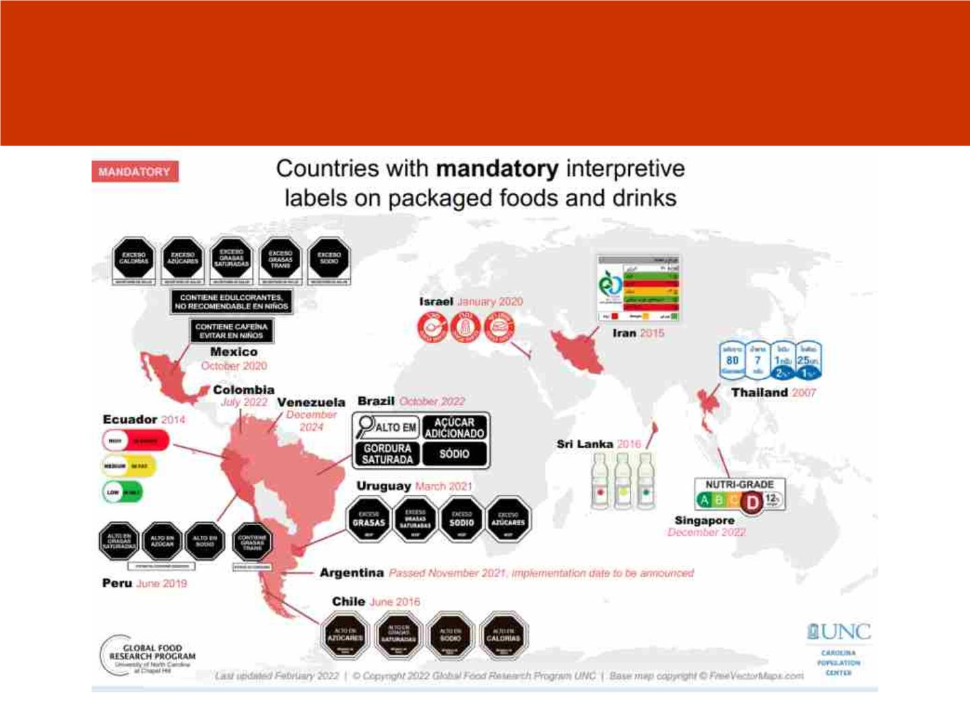
Countries using mandatory labels
NAPi

Slide 38
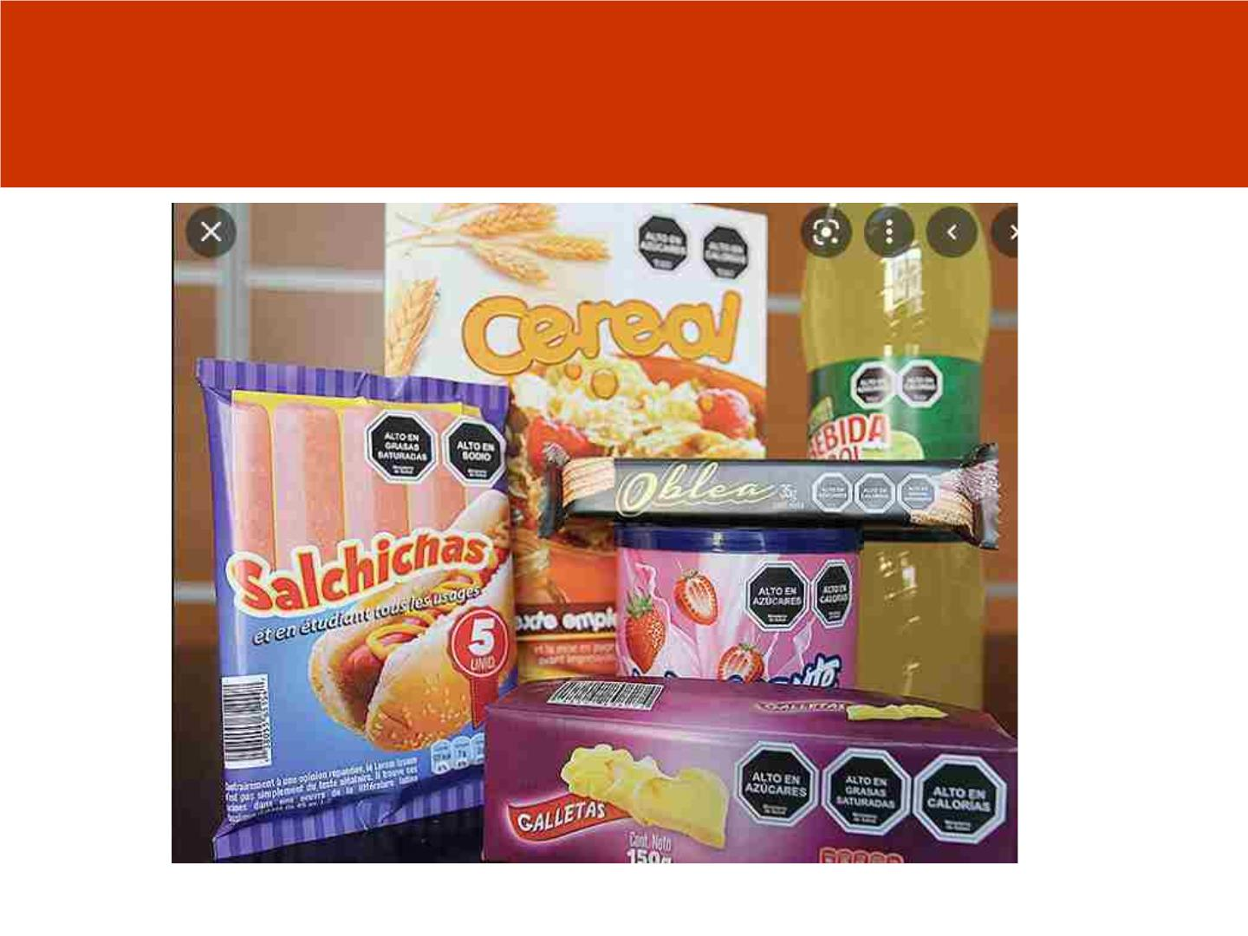
FOPL Examples from Mexico
NAPi

Slide 39
Ideas for action
• Write to Hon. Health Minister and Consumers Affairs
Minister to prevail on FSSAI and go for Warning FOPL,
which is mandatory and allow 1-2 years for
changeover.
• This is ensure Right to be informed to protect health
and Hon. SC has observed in this direction.
• Write your opinion piece in the mainstream media
• Raise this issue during Zero Hour in Parliament,
through starred or unstarred question.
• Propose a parliamentary legislation to control
marketing of UPFs and operationalize a warning FOPL.
• May like to change at your office and home.
NAPi

Slide 40
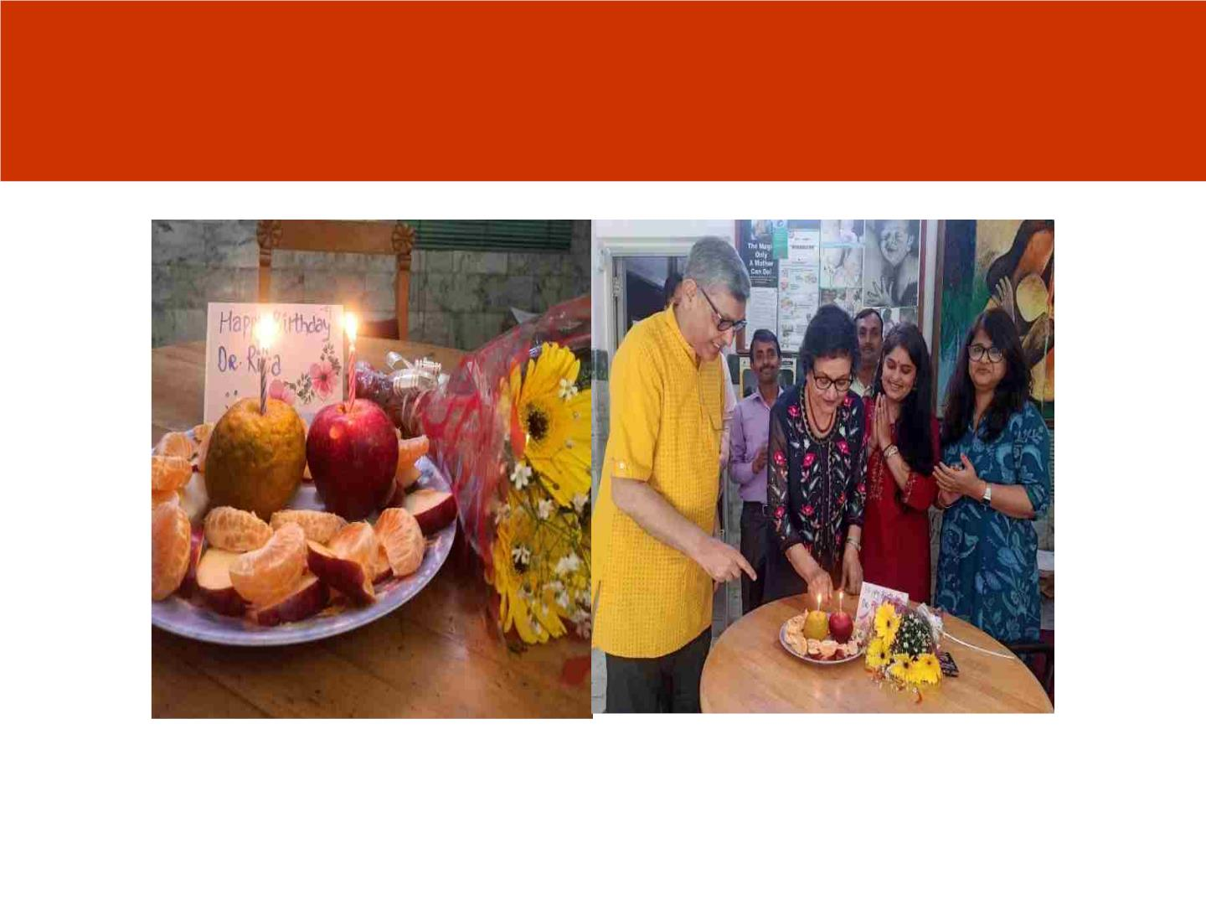
#Apples #Oranges ( Unprocessed food) replaces Cakes
(ultra-processed food product)
#Birthday #Celebrations in our Office- #Change begins at home.
NAPi

Slide 41
Thank you for your kind
attention !!
NAPi

